Slide 1
Project Title : Employee Management System
Course Title : Object Oriented Programming Sessional
Course Code : CSE 212
Presented To:
Md. Muhtadir Rahman
Lecturer
Department of Computer Science and Engineering
Port City International University
Presented By:
Ratri Palit (CSE 02107041)
Sharika Alam(CSE 02107050)
Prarona Barua (CSE 02107057)
Tikle Barua(CSE 02107068)

Slide 2
Contents
Introduction
Problem Statement
Problem Objective
Scope
Functional Requirements
Non-functional Requirements
Advantages
Disadvantages
Project Stakeholders
Cost Analysis
Conclusion

Slide 3
INTRODUCTION
This chapter summarizes the evaluation of the literature relevant to the Employee Management System. It examines theories, concepts, approaches, methods and techniques relevant to the project. Similar existing technologies relating to the development the EMS are discussed.

Slide 4
PROBLEM STATEMENT
This report’s documentation goes through the whole process of both application program and database development. It also comprises the development tools have been utilized for these purposes. This project is aimed at setting up information system about the status of the employee though a password protected system.

Slide 5
PROBLEM objective
This project aimed to simplify the task of maintaining records to the employee of the company.
To developed an well design database and store employee information .
Provides full functional reports to management of company.
The objective of this project is to provide a comprehensive approach towards the management of employee information.

Slide 6
SCOPE
The scope of this project will be limited to the following :
Employee profiles: Employees will have access to their personal profiles and will be able to edit their details.
Report generation :The HR manager will be able to generate timely reports in order to monitor employees and this can be used for performance appraisals. The reports will be have all the information of an employee from educational background, trainings attended, projects done as well as technical skills.

Slide 7
Functional requirements
Employee must be able to login to the system.
Employee must be able to view system.
Employee can register during registration period.
Employee systems can provide functionality for scheduling shifts and attendance to ensure compliance with staffing needs.
Accounting features in an HRM system promote financial planning and invoice management.

Slide 8
Non-functional requirements
The costs of creating and maintaining a new system are common non-functional issues that have an impact on the creation and development of a payroll program.
Network Bandwidth.
Flexibility.
Reliability.

Slide 9
Advantages
It saves time as it speeds up every aspect of the employee database management and payroll process with a range of automated features.
It is secure as the employee database and the payroll process is managed by the admin in house rather than sending private information to a third party.
The software is easy to use and is user friendly so no expertise is required.
Dis-advantages
It requires an internet connection.
It requires large database.

Slide 10
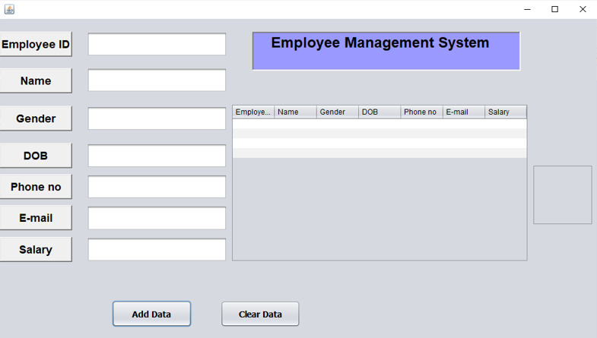
User interface

Slide 11
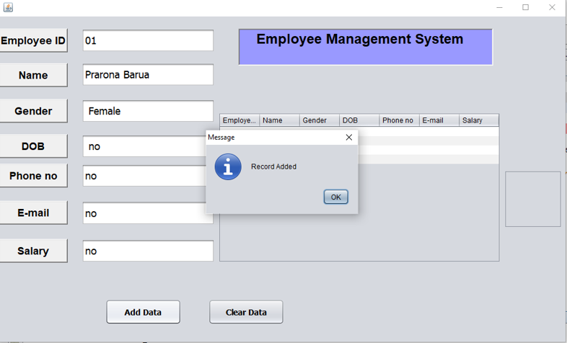
User interface

Slide 12
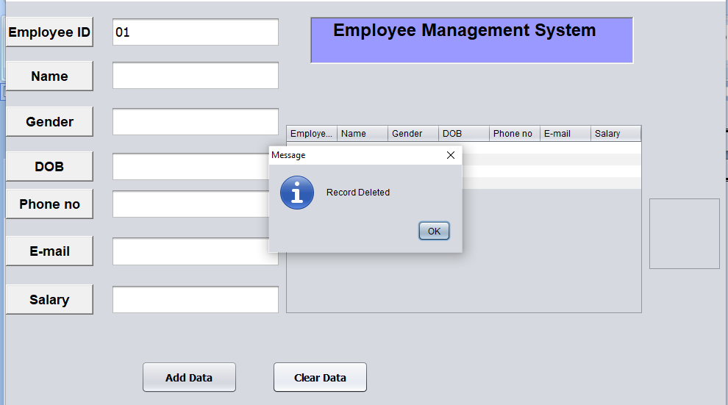
User interface

Slide 13
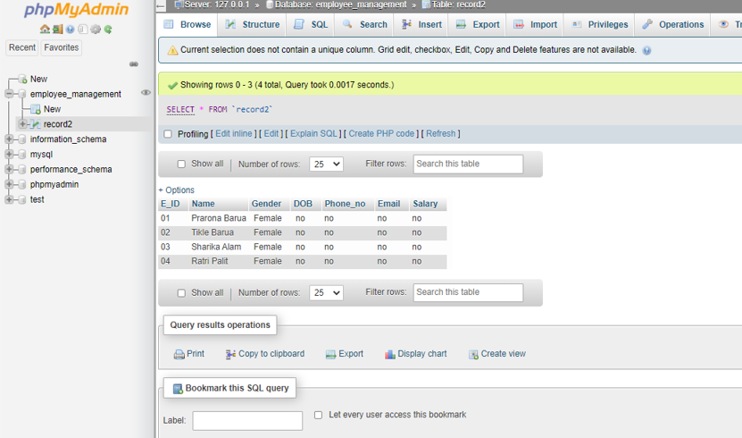
User database

Slide 14
Project stack holders
The stakeholders as in any business are those who have a stake in the business. In an opening, they are usually:
The Ownership (Investors)
The Management Company who lend their expertise, senior leadership and brand.

Slide 15
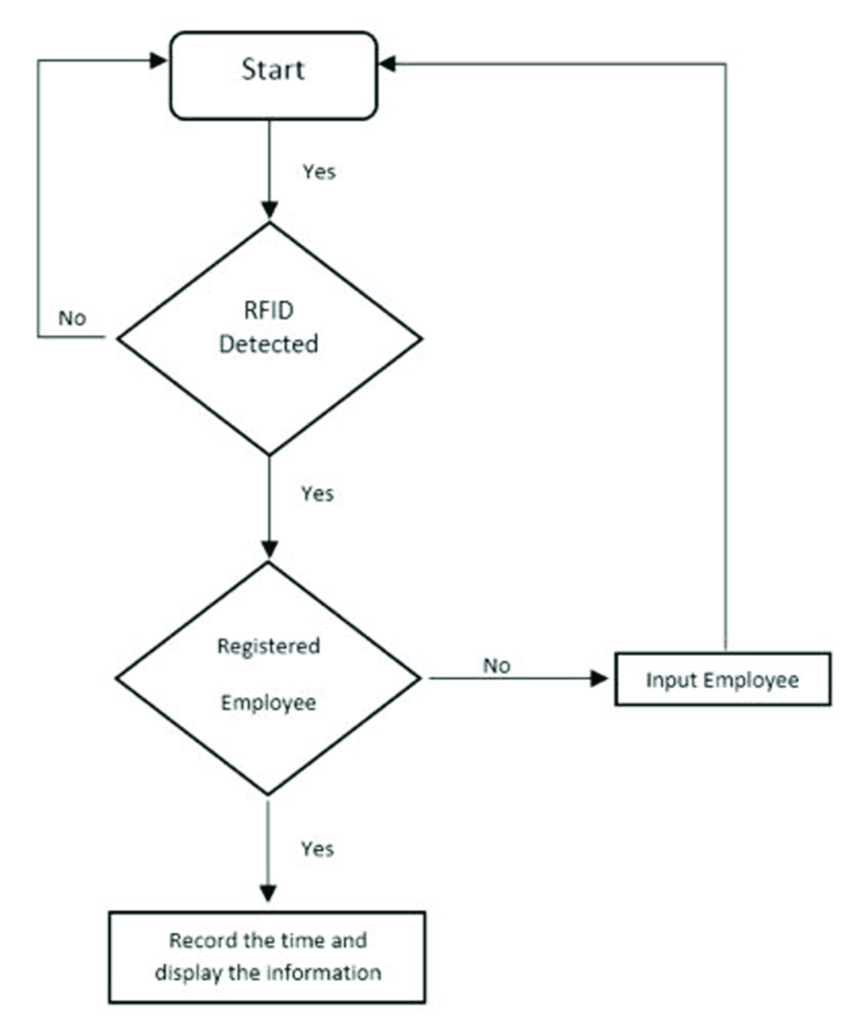


Slide 16
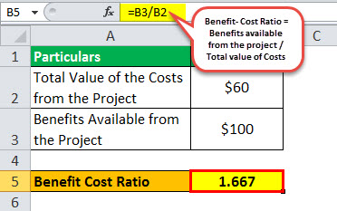
Cost analysis

Slide 17
conclusion
This project is developed using php, NetBeans and MySql fully meets the objective of the system which it has been developed. This project is used for computerizing employee management work in offices, schools, etc. The software keeps record of employee’s attendance, provident fund, gratuity and salary and generates the slip of salary too. The software is capable of easy storage of information related to employee through database.

Slide 18
Thank you

